Slide 1

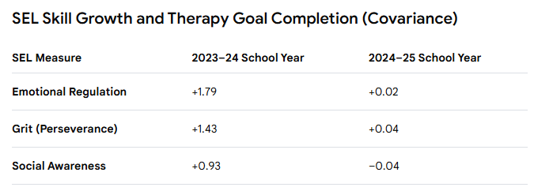
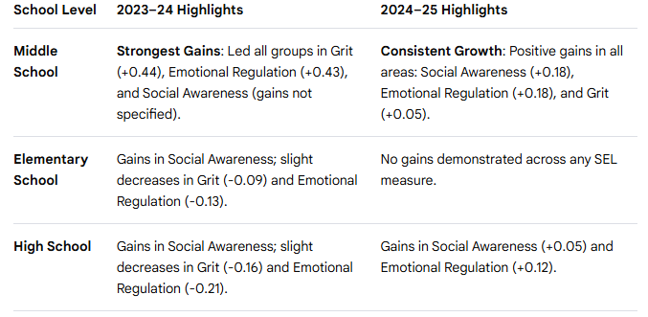
The Impact of Individualized Mental Health Therapy in the School Setting
Gina M. Hudson, Ph.D.
Matthew Johann, Ed.S.
Richmond County School System
INTRO
The current mental health program was established following the COVID-19 pandemic to address the rising number of student mental health challenges. The program grew from a single counselor to six in response to ongoing needs. Data was collected over a two-year period to measure the positive impact of the program on students' socio-emotional skills and overall well-being.
POPULATION
Students in grades K through 12 in a large southeastern school district with approximately 30,000 students (75.7% Black, 11.6% White, 7% Hispanic or Latino, 4.4% multi-racial and < 1% Asian and American Indian/Alaskan). Students who are considered Economically Disadvantaged account for 74.8% of the student population.
PROCESS
Students were referred to the Mental Health Support Counselors through a district referral system. Students must require Tier 3 supports for acceptance to therapy. MHSCs review referrals and respond within 2 days, schedule intakes with parents, and begin therapy. Students receive individual therapy for up to 16 weeks. At that time, most students are discharged or are referred out to a community agency.
RESULTS
Goal attainment was more reliable based on the number of sessions in therapy, with 6-10 sessions producing the most effective results. Across two academic years, key trends emerged in students' development of Social-Emotional Learning (SEL) skills, with middle school students consistently leading progress. Across all grades, Social Awareness improved from Fall 2023 to Spring 2024. Students who met one or more therapy goals showed a strong positive relationship with growth in all SEL measures during the 2023-24 school year. This correlation was generally sustained in 2024-25 for Perseverance (Grit COV = 0.04) and Emotion Regulation (COV = 0.02), indicating a positive link between therapeutic intervention success and SEL development.
CONCLUSIONS
The findings strongly suggest that while the current team of six mental health counselors has a demonstrable positive impact on student mental health and socio-emotional functioning, the program's reach is significantly hindered by staffing limitations, community stigma, and a lack of parental education. Expanding the counseling force is crucial to maximizing positive outcomes across the entire student population and ensuring equitable access to vital services for all families.
FUTURE DIRECTIONS
Our next steps involve translating current program outcomes into a strategic plan for scalability. The data serves as a critical leverage point for advocating for the necessary resources—specifically an increase in mental health counseling staff—to effectively address identified limitations and maximize positive mental health support district-wide.
Over 75% of students receiving in-school therapy successfully completed more than half of their treatment goals.
Students with 6-10 Sessions were most successful in meeting therapy goals.
On measures of Social-Emotional Learning skills, middle school students consistently demonstrated growth in all areas.

